Slide 1
Vehicle Speed Detection
Submitted in the partial fulfillment for the award of the degree of
BACHELOR OF ENGINEERING
IN
COMPUTER SCIENCE (AI&ML)
Submitted by:
Thanuj Reddy 18BCS6189
Tushar Chauhan 18BCS6162
Devendra Reddy 18BCS6175
Under the Supervision of:
Prof. Shikha Gupta
Department of AIT-CSE
DISCOVER . LEARN . EMPOWER

Slide 2
Outline
Introduction to Project
Problem Formulation
Objectives of the work
Methodology used
Results and Outputs
Conclusion
Future Scope
References

Slide 3
Introduction to Project
Vehicle speed detection estimates the real-time vehicle speed on roads from any real-time stream or recorded video.
This project uses OpenCV, Deep learning and computer vision.

Slide 4
The input is the video or mp4 file of any road or highway. After the computational work done at the backend in the code, the output is the objects traced by green rectangles with the speed.

Slide 5
Problem Formulation
Road accidents have been very common in the present world with the prime cause being the careless driving. The necessity to check this has been very essential and different methods have been used so far.
Traffic congestion is the main problem faced by big cities, such as Jakarta. One approach to reduce congestion levels is to improve traffic management that regulates and controls the number of vehicles.

Slide 6
Objectives
The research objectives for the Vehicle Speed Detector can be defined
as:
General Objective: Vehicle Speed Detector aims at providing accurate results of the calculated
speed of vehicle from given input stream. Specific Objectives: The model is based on basically three steps that are:
*Object detection (vehicles)
*Create the bounding box outside the vehicle
*Computing the speed of the vehicle
Immediate Objectives: We have proposed this model as this model is the need of the hour. It
helps in calculating the accurate speed of vehicles and also helps authorities to keep check on
careless drivers or on the people who are not obeying laws

Slide 7
Methodology used
The model/project used OpenCV, deep learning and computer vision for the detection of vehicles and calculate it’s speed. Object detection is applied to detect vehicles from the either input video or
real time streams.

Slide 8
UPLOAD VIDEO
PROCESSING OF VIDEO ,
APPLYING BACKGROUND SUBTRACTION
DETECTION OF VEHICLES AND SHOW THEM BY GREEN BOUNDING BOXES
DRAWING THRESHOLD LINE IN THE VIDEO FRAME
ESTIMATING THE SPEED OF VEHICLE THROUGH THE INITIAL AND FINAL COORDINATES OF THE VEHICLES
DISPLAY THE SPEED WHEN THE VEHICLE CROSSES THE THRESHOLD LINE

Slide 9
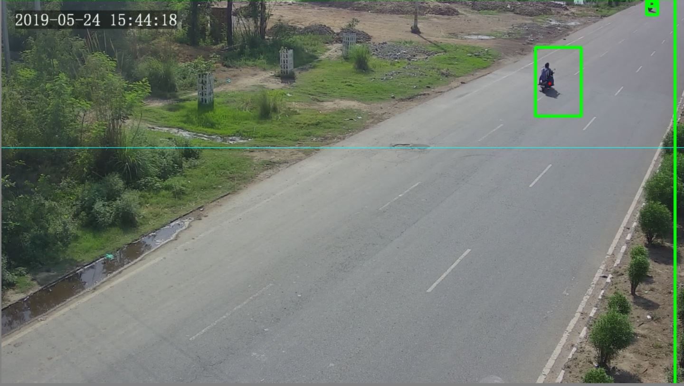
Results and Outputs
DETECTION OF VEHICLES AND THRESHOLD LINE IN A FRAME

Slide 10
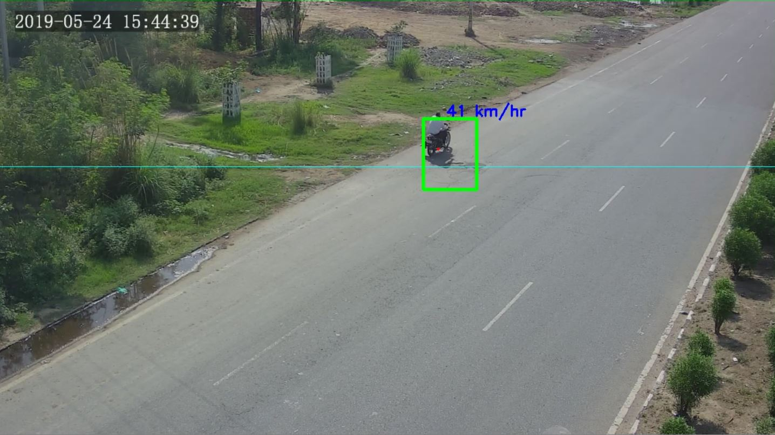
DETECTING THE SPEED

Slide 11
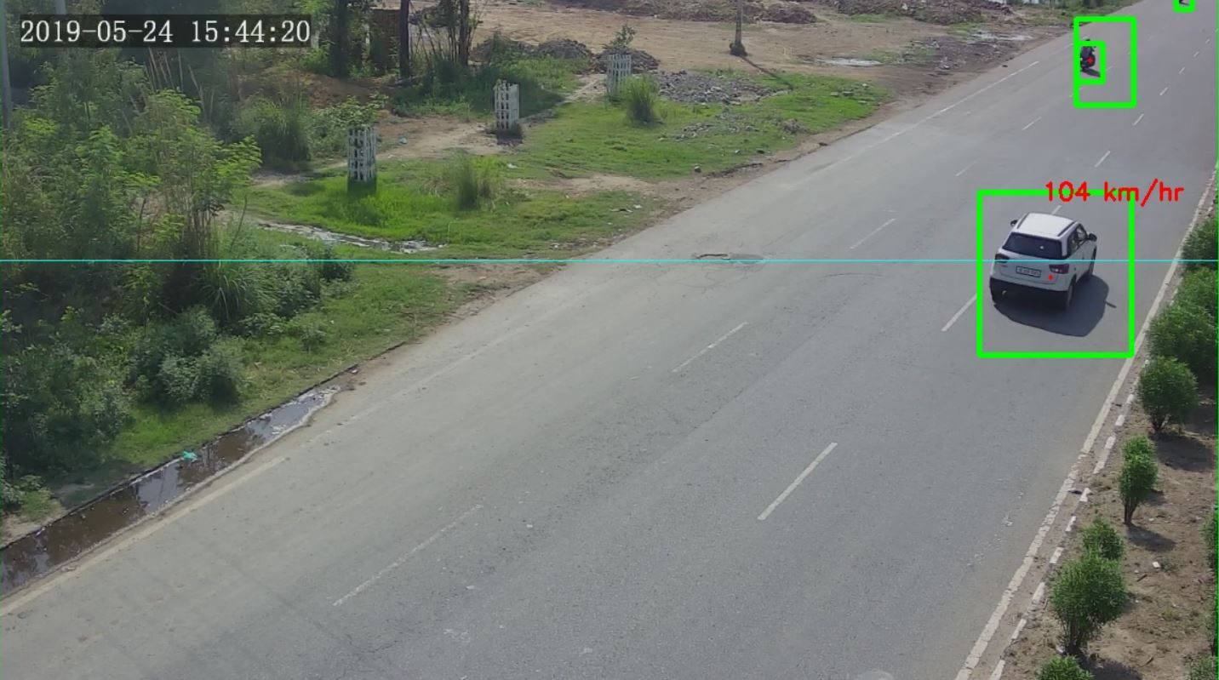

Slide 12
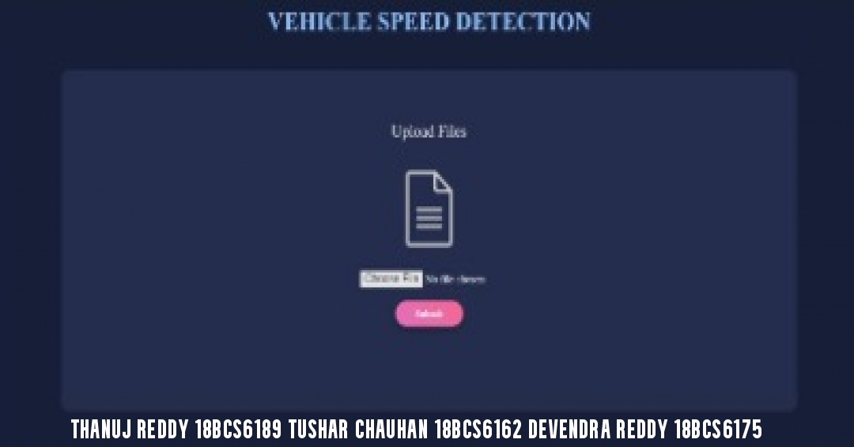
USER INTERFACE

Slide 13
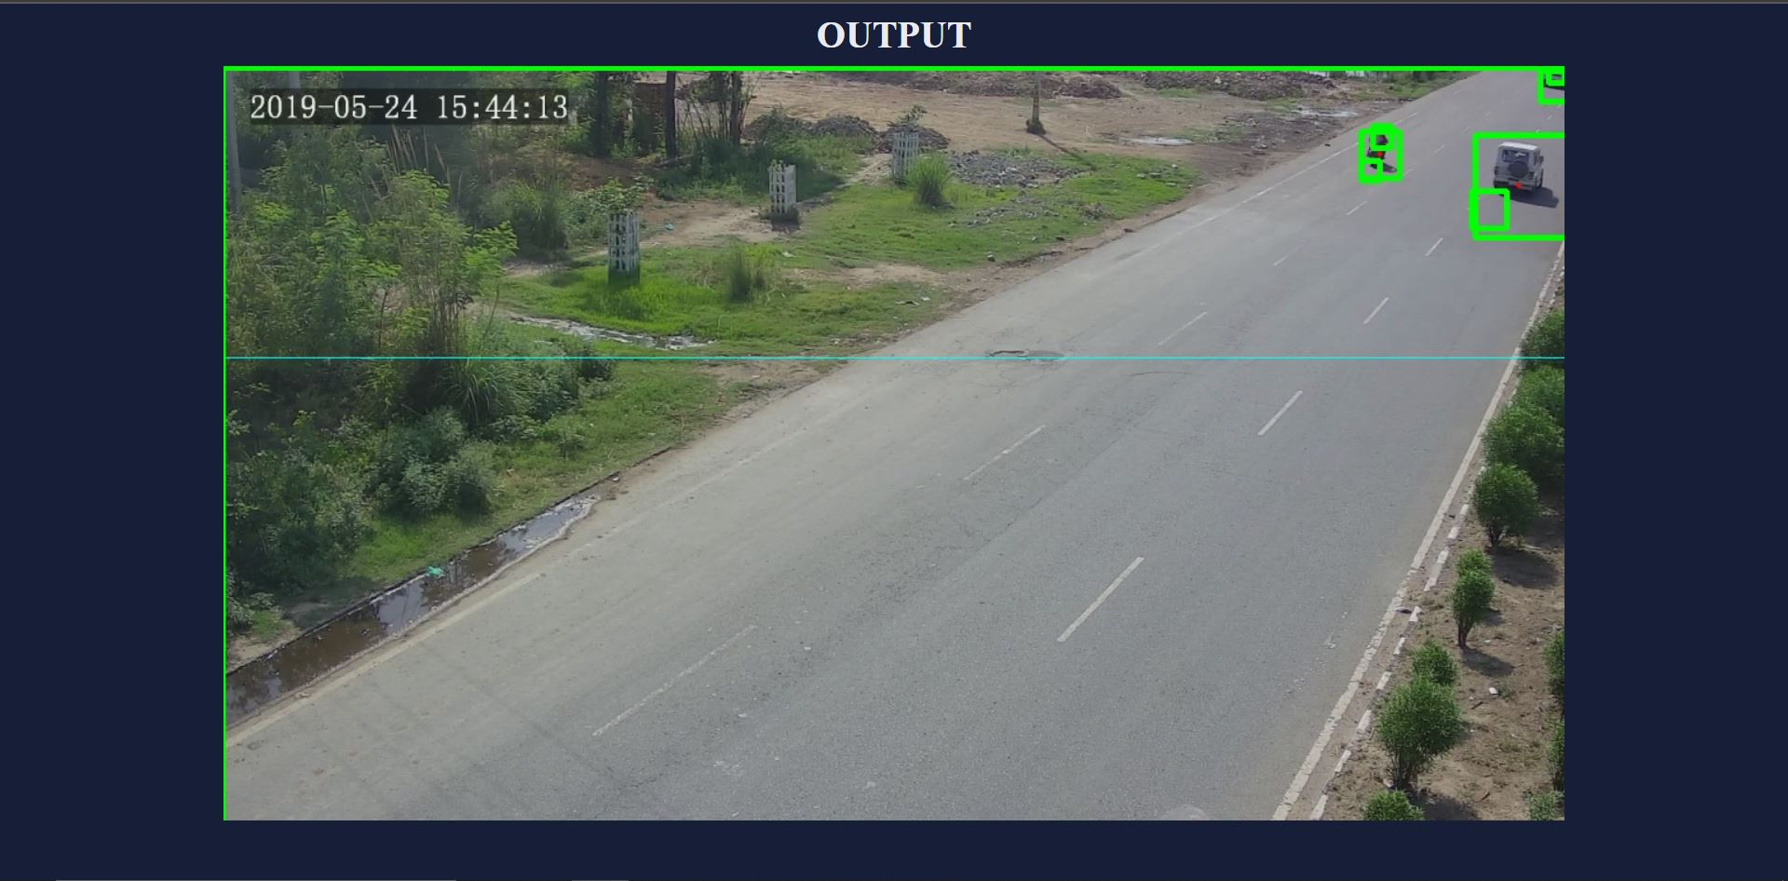

Slide 14
Conclusion
Finally, the Vehicle Speed Detection Systems have been set up in various parts of the country.
The purpose of these systems is to detect the speed of the moving vehicles.
The results of this system has positively brought the current situation of road accidents in hand and would ensure positive results in the future as well.

Slide 15
Future Scope
This system is a low cost system ensuring accurate vehicle speed detection
Easy to get system equipments
Low Maintenance and repairing cost

Slide 16
References
1.E. Atkociunas, R. Blake, A. Juozapavicius, M. Kazimianec, Image Processing in Road Traffic Analysis, Nonlinear Analysis: Modelling and Control, 2005, Vol. 10, No. 4, 315-33
2.Arash Gholami Rad, Abbas Dehghani and Mohamed Rehan Karim, "Vehicle speed detection in video image sequences using CVS method", at International Journal of the Physical Sciences Vol. 5(17), pp. 2555-2563, 18 December, 2010, ISSN 1992-1950 © 2010 Academic Journals
3.H. P. Moravec. Towards Automatic Visual Obstacle Avoidance. Proc. 5th International Joint Conference on Artificial Intelligence, pp. 584, 197

Slide 17
4..Z. Zheng, H. Wang and EKTeoh. Analysis of Gray Level Corner Detection. Pattern Recognition Letters, Vol. 20, pp. 149-162, 1999
CrossRef Google Scholar
5.Rafael C. Gonzalez and Richard E. Woods "Digital Image Processing" Prentice Hall, 2001
Google Scholar
6.D. A. Forsyth, J. Ponce. "Computer Vision. A Modern Approach", Prentice Hall, 2003
Google Scholar
7.Open source computer vision library - reference manual, INTEL Corporation, 1999-2001.
Google Scholar
8.News Article: http://articles.timesofindia.indiatimes.com/2012-06-27/ chandigarh/32439930-1-road-accidents-nakas-internalroads

